Slide 1

Design thinking
Build your project
M1 SDIA

Slide 2

Introduction
Design Thinking is a problem-solving approach that prioritizes human needs, creativity, and collaboration. It is a process that helps individuals and teams generate innovative solutions by focusing on understanding users, challenging assumptions, and rapidly prototyping ideas.

Slide 3
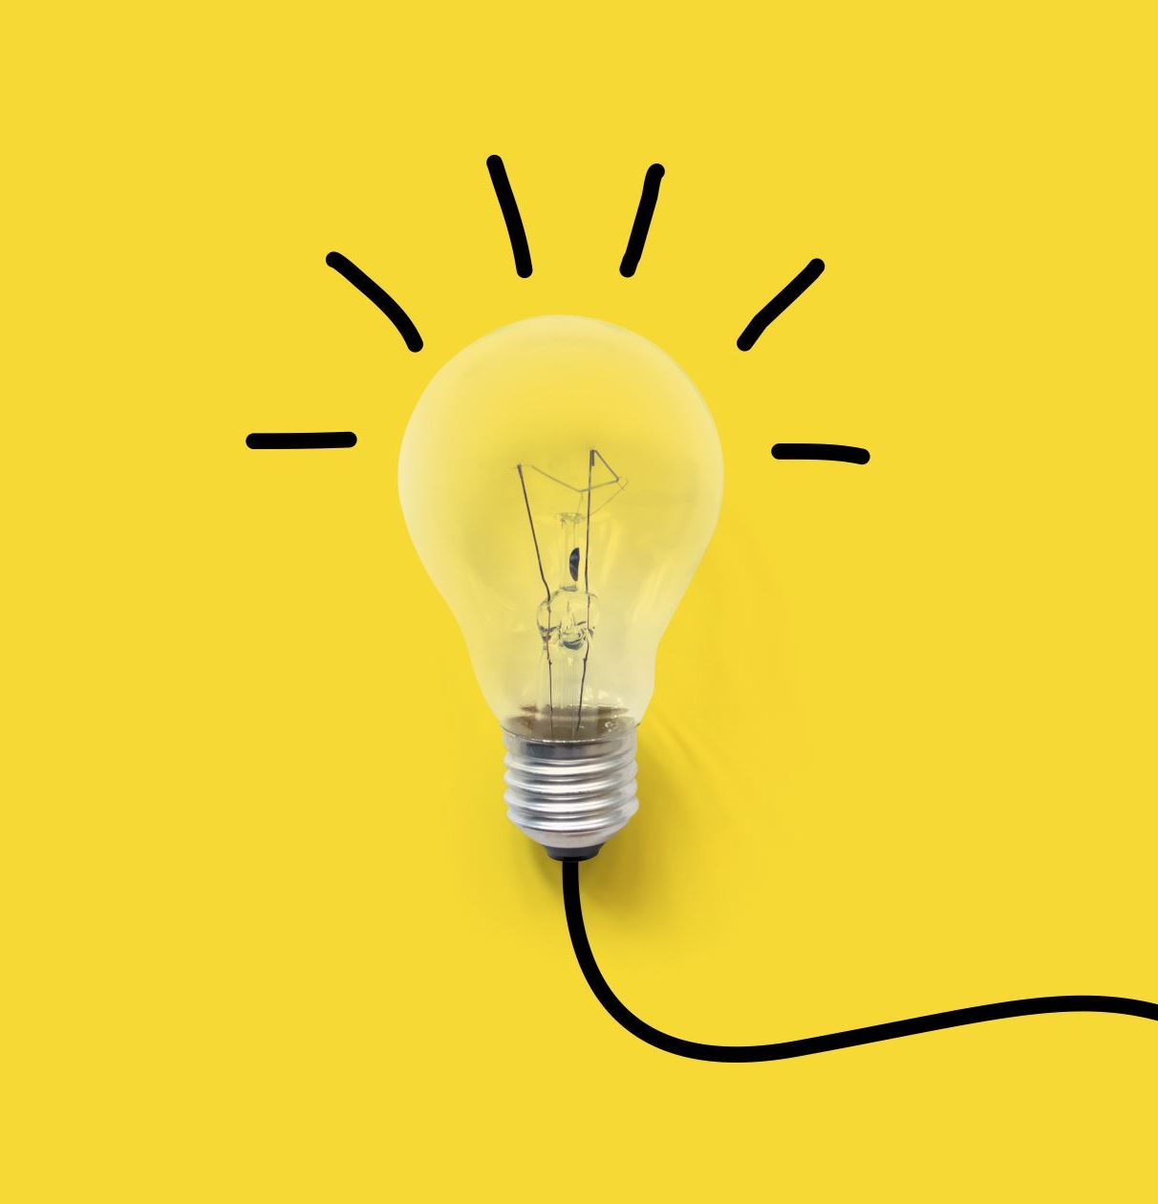
The core of the design thinking
Empathy: Understand and empathize with the users to identify their needs.
Iterative Process: Embrace an iterative approach with multiple cycles of prototyping and testing.
Collaboration: Encourage interdisciplinary collaboration and diverse perspectives.

Slide 4
Process
Empathize: This stage involves conducting research, interviews, and observations to gain a deep understanding of users and their needs.
Ideate: This stage encourages divergent thinking and the generation of a wide range of ideas.
Prototype: Prototyping is the process of creating low-fidelity representations of potential solutions. It allows designers to quickly visualize and test ideas, gather feedback, and iterate on their designs.
Test: Testing involves gathering feedback from users and stakeholders on the prototypes. Iterative testing and refinement are critical in Design Thinking to ensure continuous improvement.
Define: the problem or challenge is defined based on the insights gathered during the empathy phase. It involves synthesizing the research findings and reframing the problem statement to ensure a clear focus.

Slide 5
Empathy and Human-Centered Design
Empathy is a fundamental aspect of Design Thinking and is closely tied to the concept of human-centered design.
It involves understanding and connecting with the experiences, emotions, and needs of the people for whom a product, service, or solution is being designed.
Empathy is crucial because it allows designers to gain deep insights into users' perspectives, motivations, and challenges, which in turn informs the entire design process

Slide 6
key aspects of empathy and human-centered design:
User Research: designers engage in user research activities such as interviews, observations, and immersions. They seek to understand users' behaviors, needs, desires, and pain points within the context of the problem they are trying to solve. By directly interacting with users, designers can gather rich qualitative data and insights,
Empathy Mapping: Empathy mapping is a tool used to synthesize and organize the insights gained from user research. It involves creating a visual representation of users' thoughts, feelings, actions, and motivations. Empathy maps help designers develop a more holistic understanding of users, enabling them to identify patterns, uncover hidden needs, and generate meaningful design solutions.
Personas: Personas are fictional characters that represent different user archetypes. They are created based on the collected user research and serve as a tool to bring users to life throughout the design process. Personas help designers maintain a user-centered focus by reminding them of the diverse needs, goals, and behaviors of the target users.
Iterative Feedback: Throughout the design process, empathy is maintained by continuously seeking feedback from users. Prototypes are shared and tested, and designers actively listen to users' reactions and suggestions. By incorporating user feedback into iterations, designers refine their solutions and ensure they align with users' expectations and preferences.

Slide 7
Techniques for conducting user research and interviews
Contextual Inquiry
Surveys and Questionnaires
Diary Studies
Card Sorting
Empathy Interviews
Co-Creation Workshops
Usability Testing

Slide 8
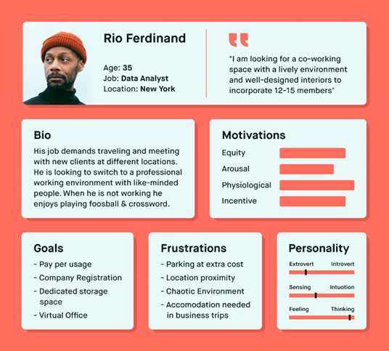
User personas
a) Gather User Research: Start by collecting data from user interviews, observations, surveys, or any other relevant sources. Identify common patterns, behaviors, and demographics among the users.
b) Identify User Segments: Group users into distinct segments based on similarities in their goals, behaviors, preferences, or other relevant criteria. Each segment will represent a different persona.
c) Define Persona Attributes: For each persona, define key attributes that describe their characteristics. This includes demographic information (age, gender, occupation), goals, motivations, challenges, preferences, and any other relevant details.
d) Add Context and Narrative: Bring the persona to life by adding context and creating a narrative around their experiences.
e) Visualize the Persona: Create a visual representation of the persona, including a name, picture, and key attributes. This helps make the persona more relatable and memorable for the design team.
f) Validate and Refine:

Slide 9
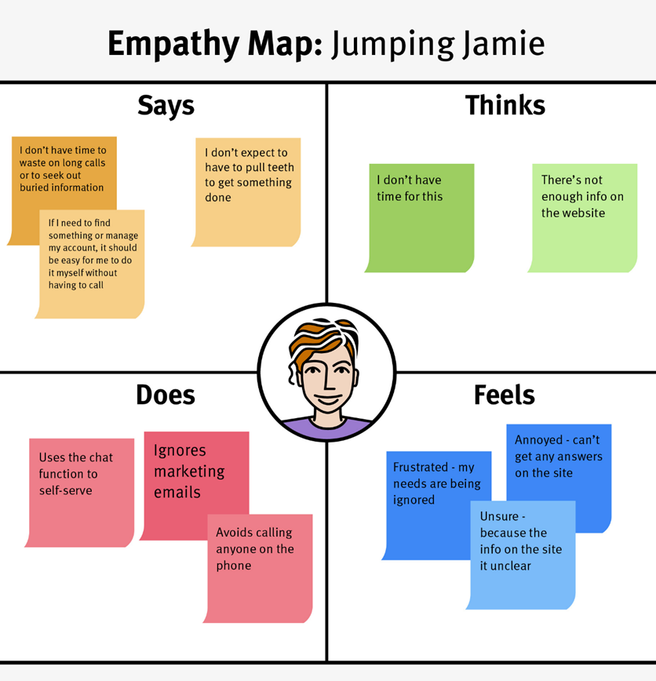
Empathy maps
Define the User: Identify the user or user segment for whom the empathy map will be created. It should be based on the personas or specific user groups relevant to the design challenge.
Divide the Map: Divide the empathy map into four quadrants: "Says," "Thinks," "Feels," and "Does." These represent different aspects of the user's experience.
Gather Insights: Based on user research and observations, fill in each quadrant with the relevant insights. Focus on capturing specific statements, thoughts, emotions, and actions related to the user's experience.
Identify Patterns: Look for patterns and connections between the insights. Identify recurring themes, pain points, motivations, …..
Prioritize and Highlight: Highlight the most important or impactful insights within each quadrant. These are the key points that will guide the design process.
Synthesize and Communicate: Summarize the insights from the empathy map in a concise and visually appealing format. Use visuals, keywords, or short phrases to communicate the user's experience effectively.

Slide 10

Problem Definition
Reframe the Problem Statement: Begin by reframing the initial problem statement based on the insights gained from user research and empathy. This involves clearly defining the problem in a way that focuses on the user's needs, motivations, and pain points. The reframed problem statement should inspire creativity and guide the ideation process.
Define Design Criteria: Establish the criteria that the solution should meet. These criteria should align with the users' needs and the desired outcomes. Consider factors such as usability, feasibility, desirability, and impact. This helps set clear goals and parameters for the ideation phase.
Prioritize and Scope: Prioritize the identified problems based on their importance and impact on users. Determine which problems are most critical to address within the given constraints. Scoping the problem helps ensure that the subsequent ideation efforts are focused and directed towards the most significant challenges.

Slide 11
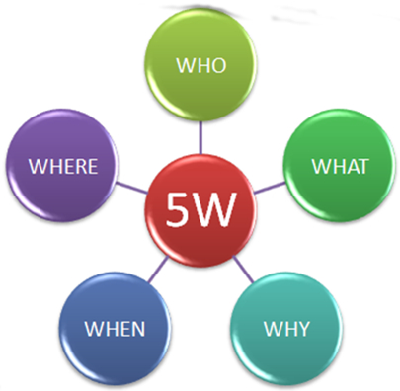
Problem Definition
Who: Who is affected by the problem?
What: What is the current state of the problem, and what is the desired state of the problem? Alternatively, what is the magnitude of the problem?
When: When will the problem occur? Alternatively, how long has the problem been going on?
Where: Where is the problem occurring?
Why: Why is this problem important or worth solving?

Slide 12
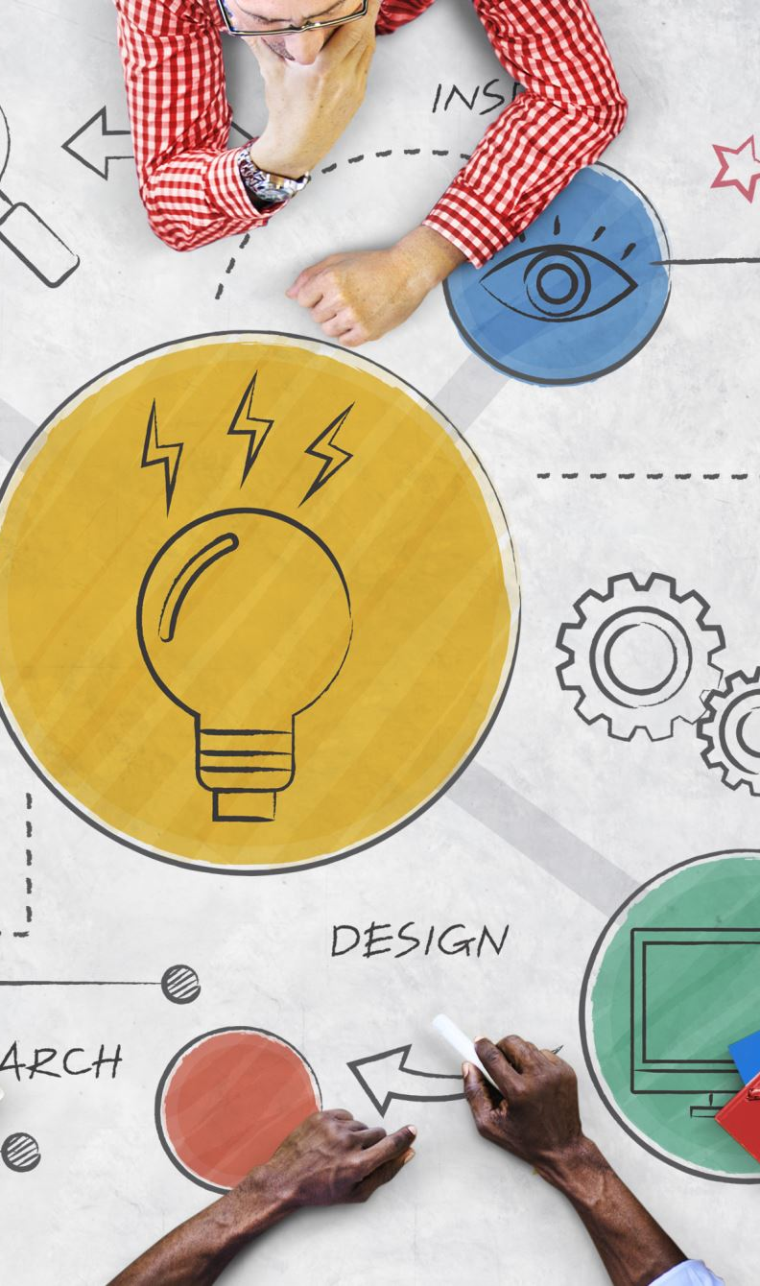
Ideation
Generate Diverse Ideas: Encourage participants to generate a wide range of ideas without judgment or evaluation. Emphasize quantity over quality at this stage.
Build on Others' Ideas: Encourage participants to build on each other's ideas and collaborate.
Stimulate Creativity: Use various ideation techniques to stimulate creativity. These may include visual brainstorming, role-playing, sketching, or using analogies and metaphors.
Encourage Wild Ideas: Encourage participants to think beyond conventional solutions and generate wild or unconventional ideas.
Prototype and Iterate: As ideas emerge, consider creating low-fidelity prototypes or mock-ups to visualize and test the concepts. Prototyping helps to refine and iterate on the ideas, gather feedback, and ensure the feasibility and desirability of the solutions.
Evaluate and Select Ideas: Review and evaluate the generated ideas against the defined design criteria. Consider the potential impact, feasibility, and alignment with user needs. Select the most promising ideas to move forward for further development.

Slide 13
Ideation techniques
Mind Mapping: Start with a central idea or problem statement and create a visual map of related concepts, ideas, and associations. This technique helps generate a network of interconnected thoughts and can generate new ideas by exploring different branches and connections.
SCAMPER: SCAMPER is an acronym that stands for Substitute, Combine, Adapt, Modify, Put to another use, Eliminate, and Reverse. This technique prompts you to think about each element of your project or problem and consider ways to modify or manipulate it to generate new ideas.
Brainstorming: Gather a group of individuals and encourage them to freely generate as many ideas as possible without judgment or evaluation. The goal is to promote a creative and open environment where participants can build upon each other's ideas and inspire new ones.

Slide 14
Reverse Thinking: Instead of solving a problem directly, approach it from the opposite perspective. Ask yourself how you can achieve the opposite outcome or create obstacles, and then brainstorm ideas to overcome those obstacles. This technique can help break conventional thinking patterns and stimulate innovation.
Six Thinking Hats: This technique involves wearing different "hats" that represent different thinking styles. Each hat represents a specific perspective: facts and information (white), emotions and intuition (red), critical judgment (black), optimism and benefits (yellow), creativity (green), and control and organization (blue). By systematically switching between these hats, you can explore ideas from multiple angles.
Random Stimulus: Introduce a random word, image, or object into the ideation process and challenge yourself to connect it to your project or problem. This technique encourages lateral thinking and can lead to unexpected and creative ideas.
Analogies and Metaphors: Draw parallels between your project or problem and unrelated domains or concepts. By identifying similarities and transferring ideas from one context to another, you can generate fresh perspectives and innovative solutions.

Slide 15

Prototype
Prototyping and iteration are crucial stages in the design thinking process.
They involve creating tangible representations of ideas and continuously refining them based on user feedback and insights.
Paper Prototyping: Paper prototyping involves sketching or drawing rough representations of the design on paper. It is a low-cost and quick way to visualize and communicate ideas.
Digital Prototyping: Digital prototyping involves using software tools to create interactive mock-ups or wireframes of the design. Tools like Adobe XD, Sketch, Figma, or InVision allow designers to create clickable prototypes that simulate the user experience. Digital prototyping facilitates realistic interactions and can be used for user testing and validation.
Physical Prototyping: Physical prototyping involves creating tangible, three-dimensional models or mock-ups of the design. It can be done using materials like clay (عجينة), cardboard, or 3D printing. Physical prototypes are useful for testing ergonomics, form factor, and physical interactions.
Functional Prototyping: Functional prototyping involves creating prototypes that mimic the functionality of the final product or service. It may involve using hardware components, coding, or programming to create a working prototype. Functional prototypes help test and validate technical feasibility and user experience.

Slide 16
Tests
Usability Testing: Conduct usability testing sessions where users interact with the prototype and perform specific tasks. Observe and gather feedback on their interactions, pain points, and suggestions for improvement. Usability testing helps identify usability issues and informs design refinements.
A/B Testing: A/B testing involves comparing two or more versions of a prototype or design to determine which performs better in achieving the desired outcomes. By presenting different variations to different users and analyzing their responses, designers can optimize the design based on data-driven insights.
Co-Creation Workshops: Organize workshops or collaborative sessions where users, stakeholders, and designers come together to interact with and provide feedback on the prototype. Co-creation workshops foster engagement, generate new ideas, and ensure that the design reflects diverse perspectives and needs.

Slide 17
Conclusion
Rapid Iteration and Continuous Improvement
Ethical Considerations and Responsible Design Practices
Thinking is a vital cognitive process that enables analysis, problem-solving, and decision-making.
Thinking techniques and tools, such as brainstorming and mind mapping, provide structure and stimulate creativity in generating ideas and solutions.
Collaborative thinking, involving multiple perspectives and open communication, enhances the quality and innovation of outcomes.
Developing thinking skills through practice, reflection, and continuous learning empowers individuals to become better problem solvers and decision-makers.

